Slide 1
Azure Machine Learning
Microsoft Research
Windows Azure for Research Training

Slide 2
Azure Machine Learning
Key learning objectives
Understand what machine learning is
How to use Azure Machine Learning Studio
Apply machine learning to solve a problem

Slide 3
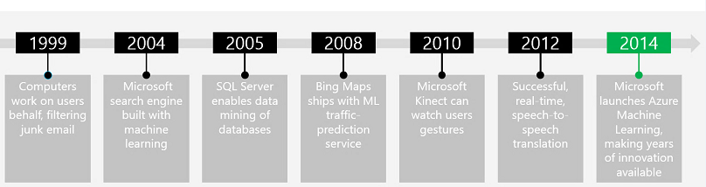


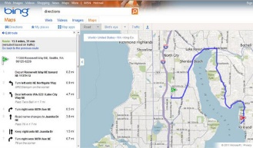
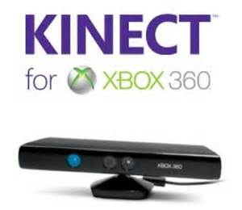
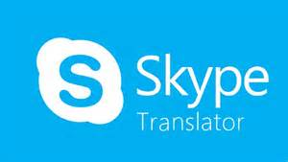


Microsoft Machine Learning History
Modified from http://pulsweb.fr/predict-wine-quality-azureml

Slide 4
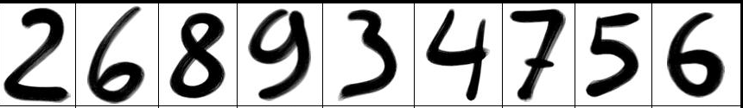

Quick Lesson on Supervised Learning
Accuracy = 100%
Accuracy = 50%
2 6 8 9 3 4 7 5 6
Train -> Score
Evaluate
Score
Publish
5 1
5 6
Model

Slide 5
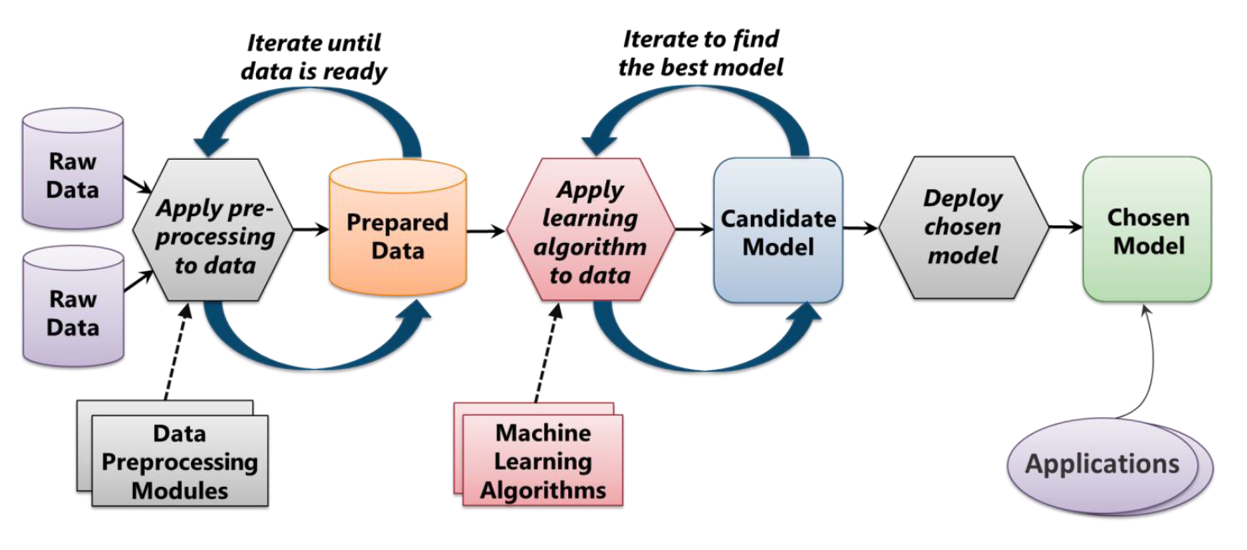
Machine Learning Process
From: Introduction to Microsoft Azure by David Chappell

Slide 6
Samples of Algorithms Available
Regression
Baysian Linear Regression
Boosted Decision Tree Regression
Decision Forest Regression
Fast Forrest Quantile Regression
Linear Regression
Neural Network Regression
Ordinal Regression
Poisson Regression
Evaluate
Cross Validate Model
Evaluate Mode
Evaluate Recommender
Classification
Multiclass Decision Forest
Multiclass Decision Jungle
Multiclass Logistic Regression
Multiclass Neural Network
One-vs-All Multiclass
Two-Class Average Perceptron
Two-Class Bayes Point Machine
Two-Class Boosted Decision Tree
Two-Class Decision Forrest
Two-Class Decision Jungle
Two-Class Locally-Deep Support Vector Machine
Two-Class Logistic Regression
Two-Class Neural Network
Two-Class Support Vector Machine

Slide 7
Samples of Algorithms Available
OpenCV Library Modules
Image Reader
Pre-trained Cascade Image Classification
Python Language Modules
Execute Python Script
R Language Modules
Create R Model
Execute R Script
Text Analysis
Feature Hashing
Named Entity Recognition
Vowpal Wabbit Score
Vowpal Wabbit Train
Statistical Functions
Apply Math Operation
Descriptive Statistics
Elementary Statistics
Hypothesis Testing T-Test
Linear Correlation
Probability Function Evaluation
Replace Discrete Values

Slide 8
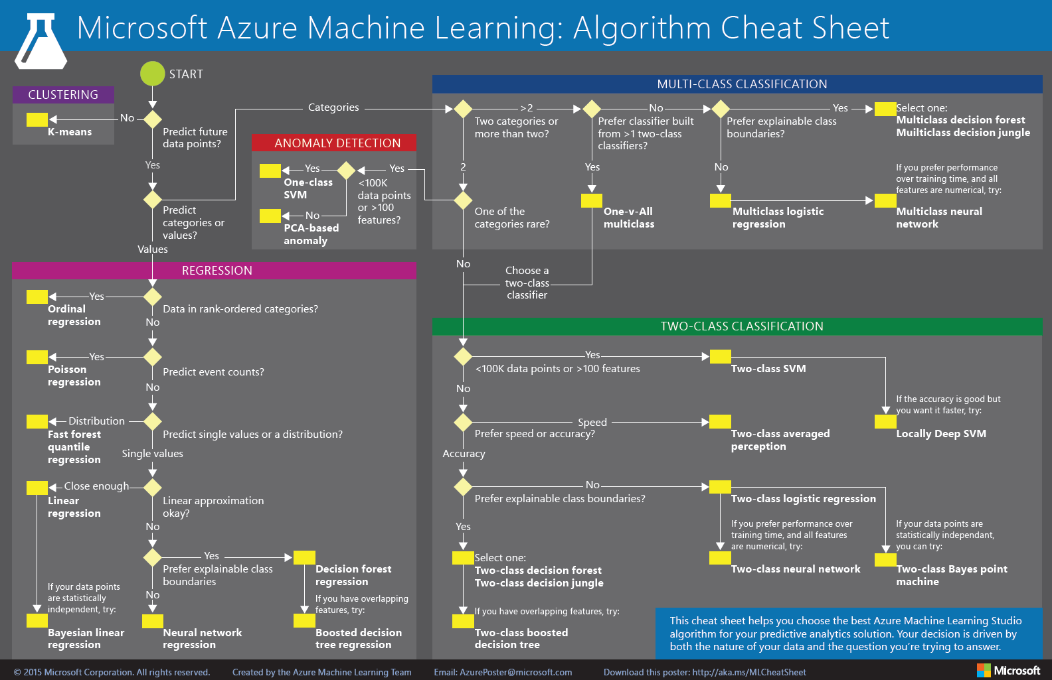
http://aka.ms/MLCheatSheet

Slide 9
Hands-On Lab
Using Azure Machine Learning
MachineLearningHOL.pdf

